Slide 1

Information Retrieval
Elastic Search, Kibana and Python Search Engine
Student ID: 1804900

Slide 2
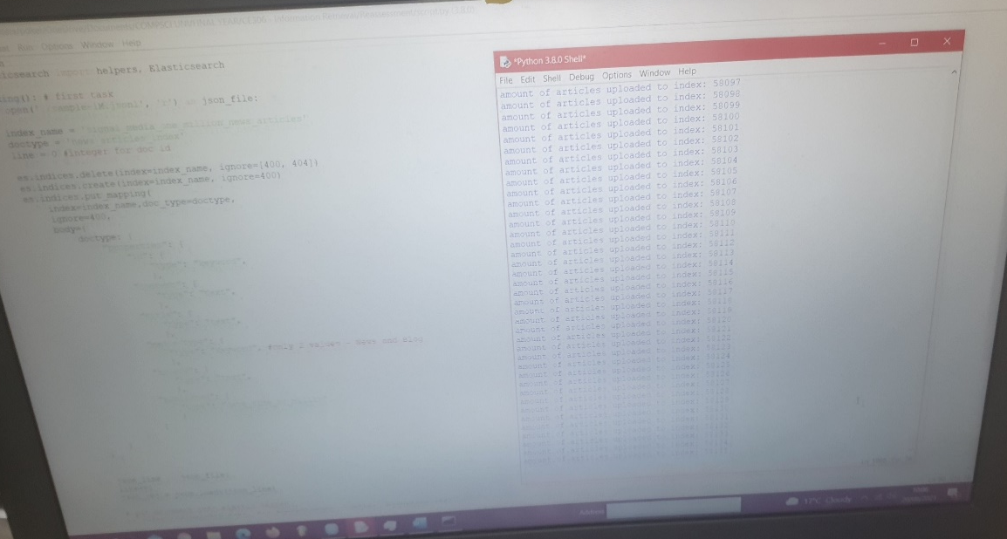
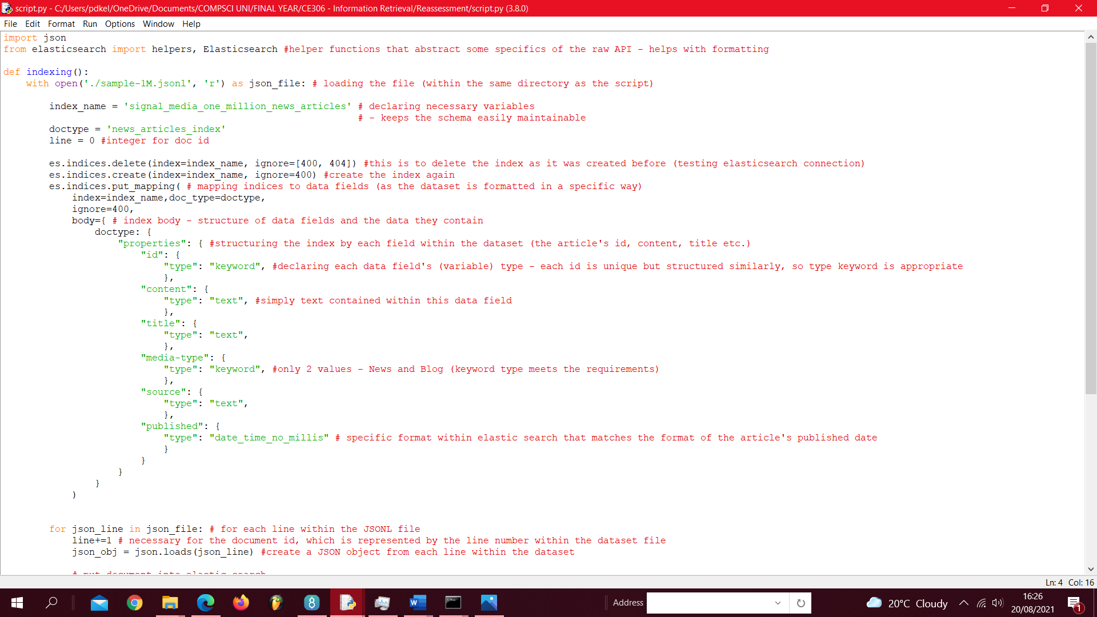
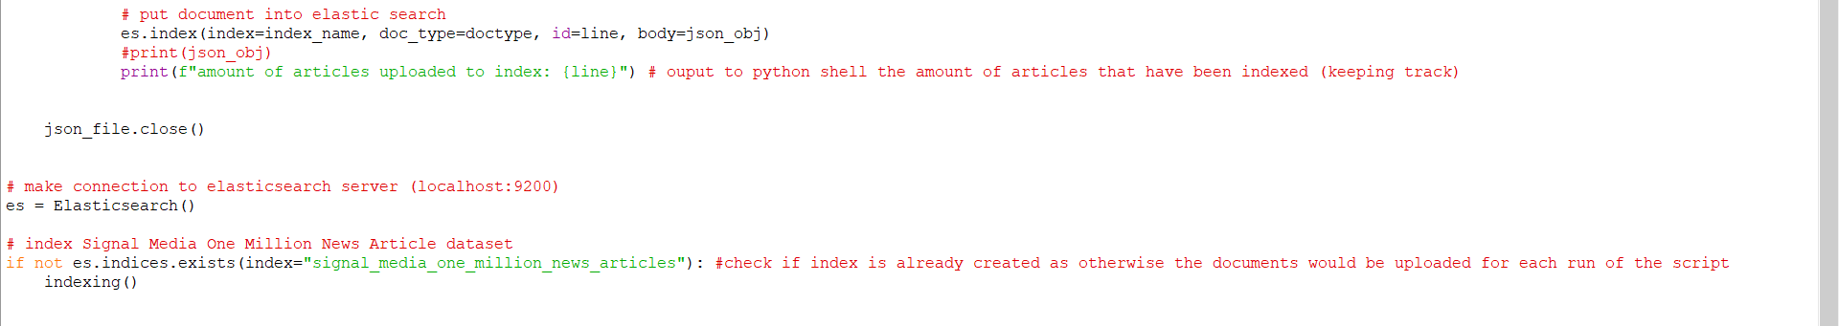
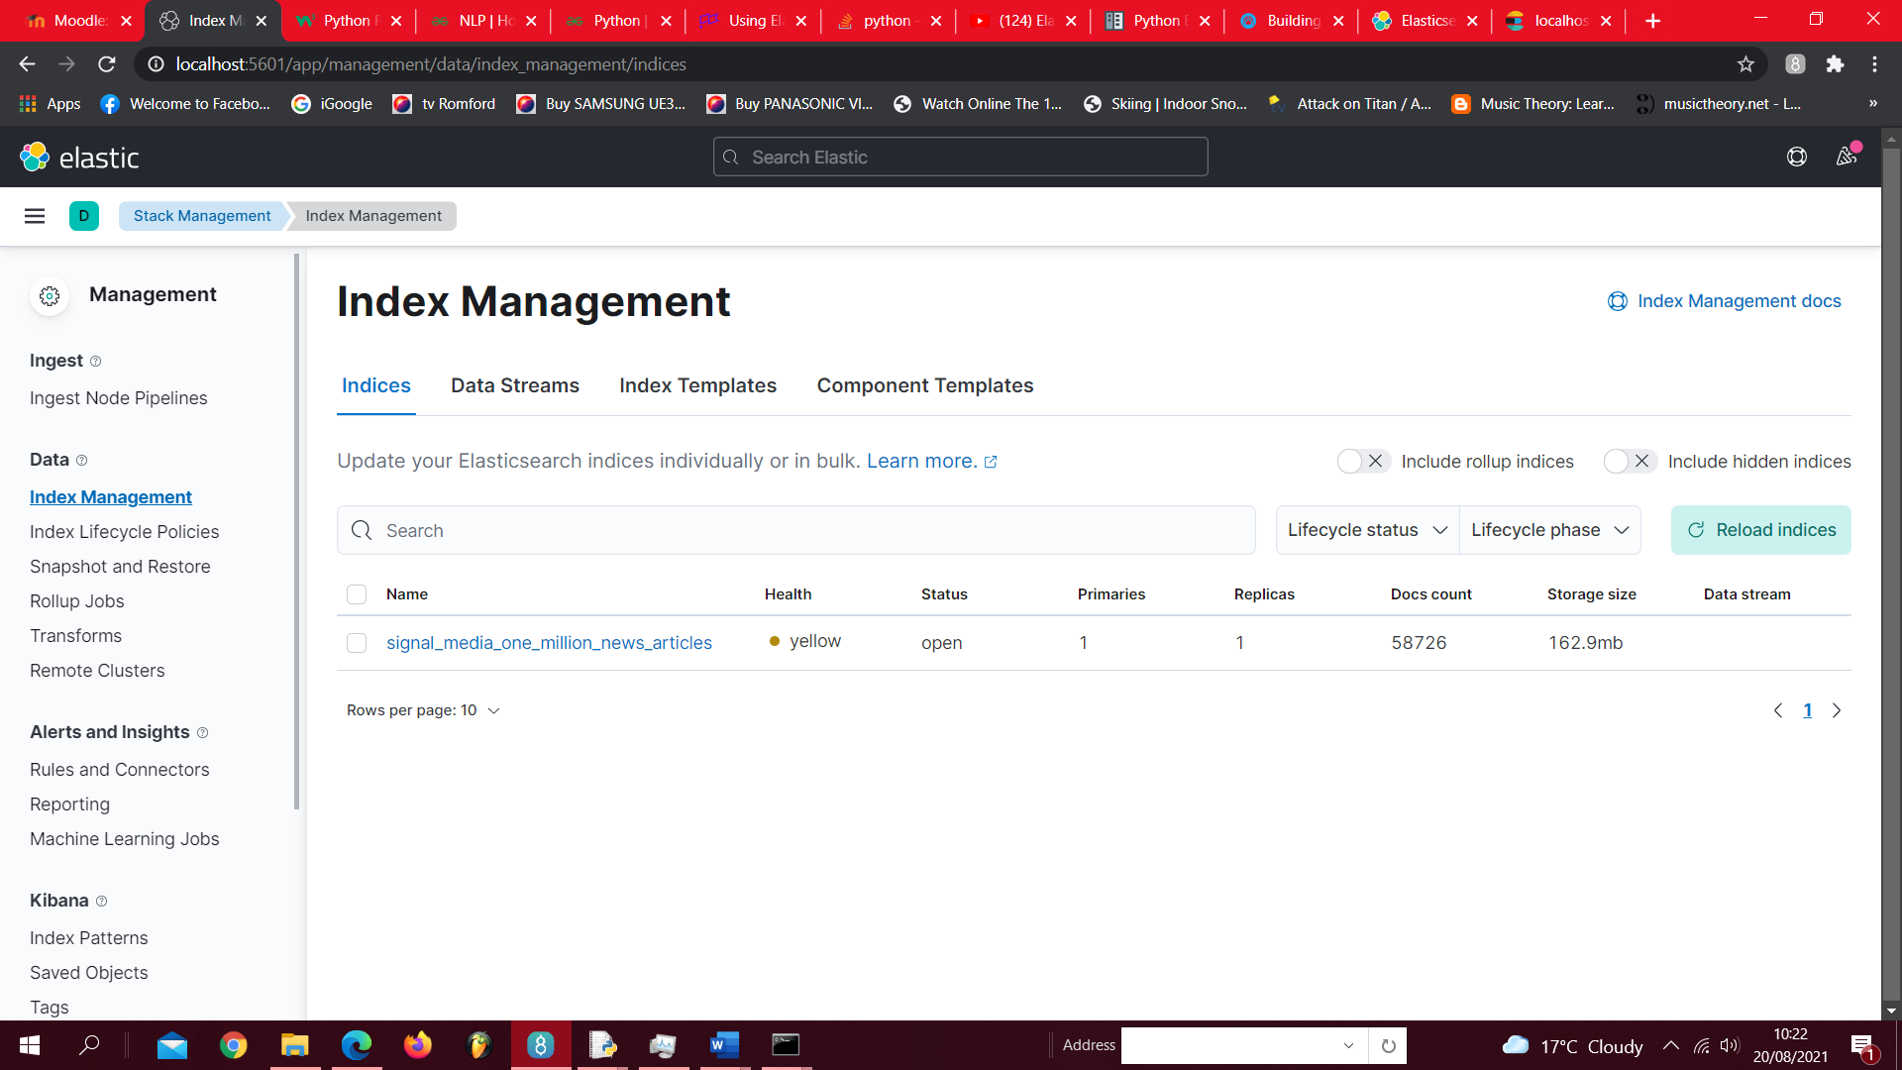
Script -> python output -> create elastic index

Slide 3
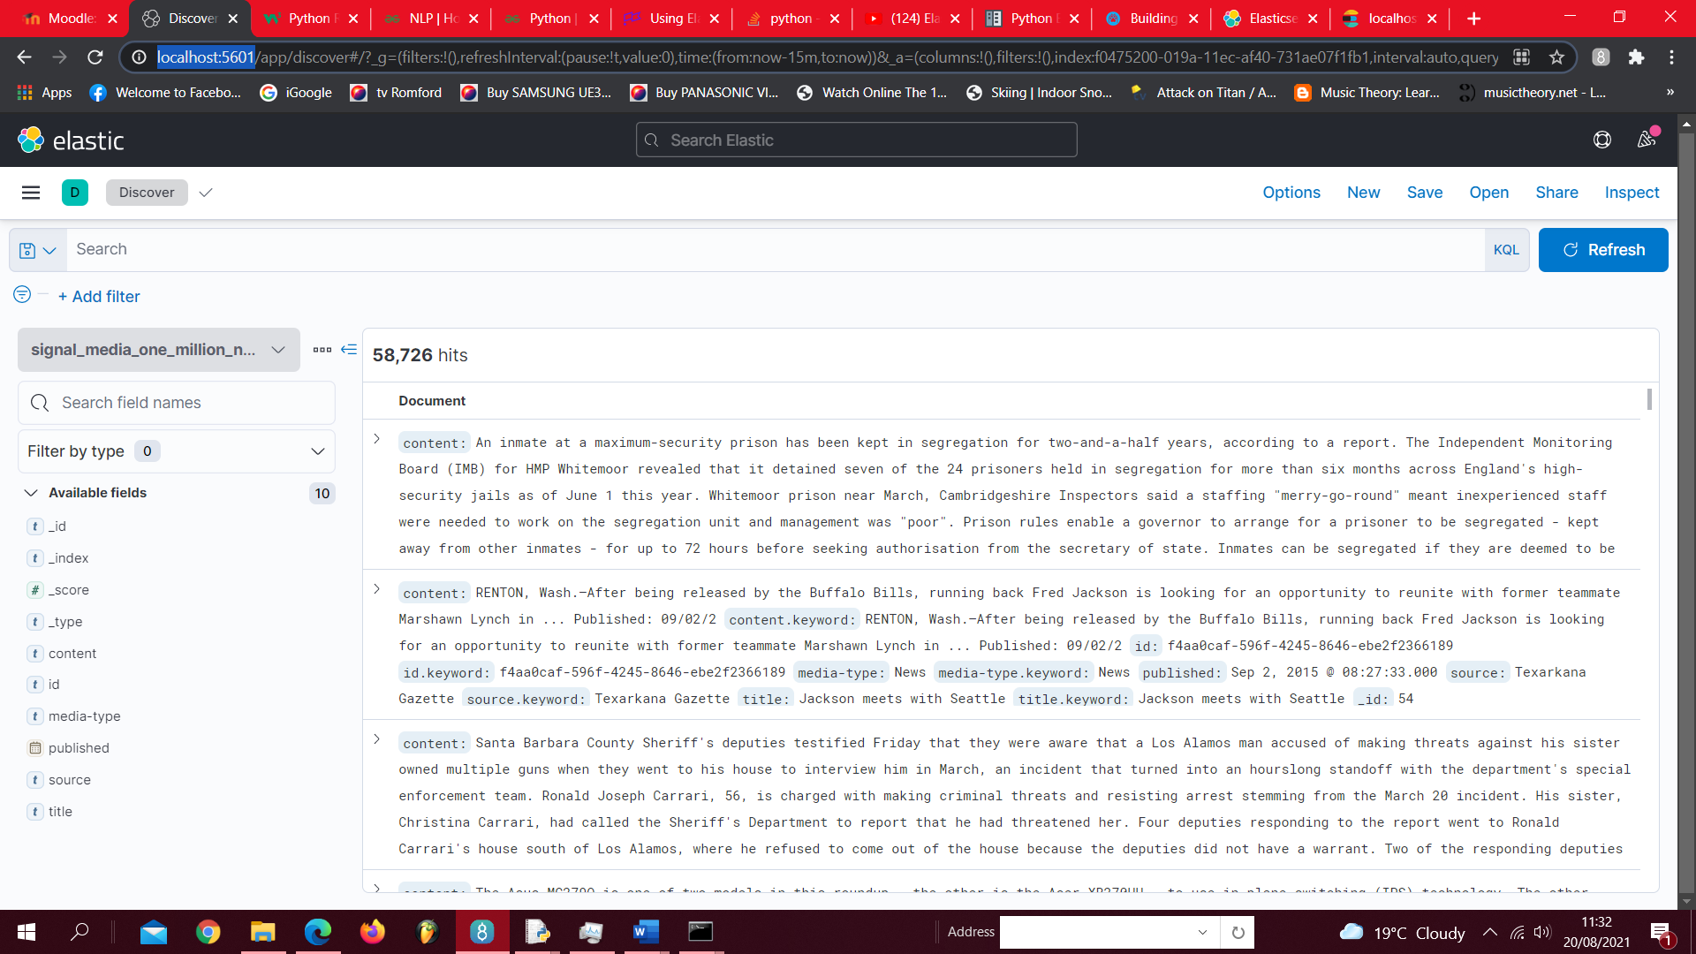
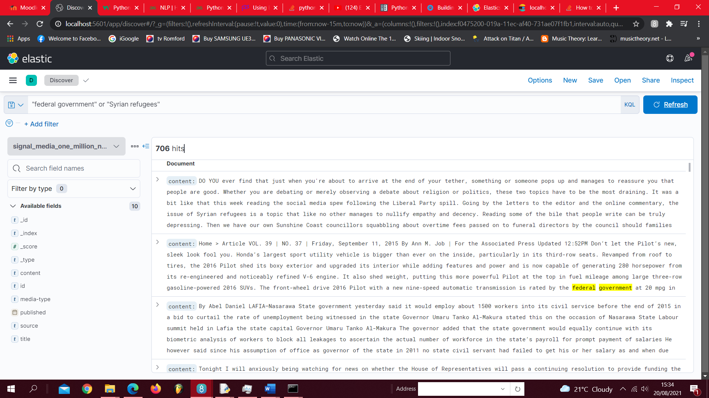
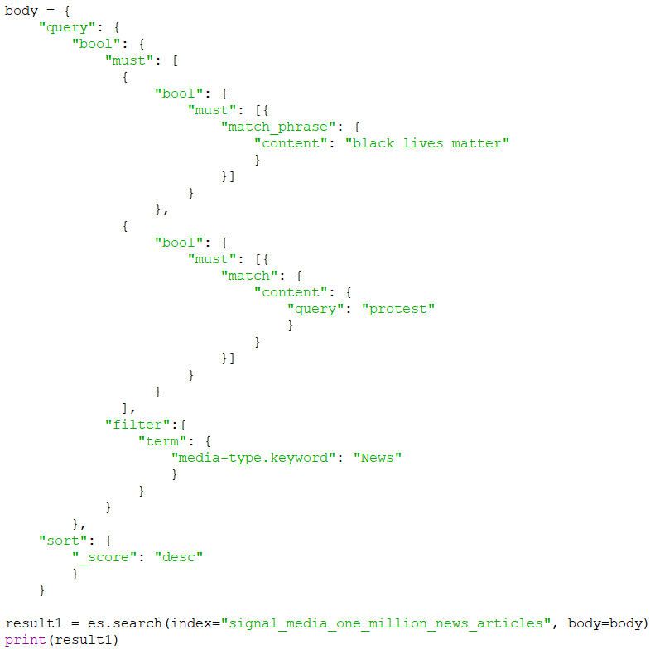

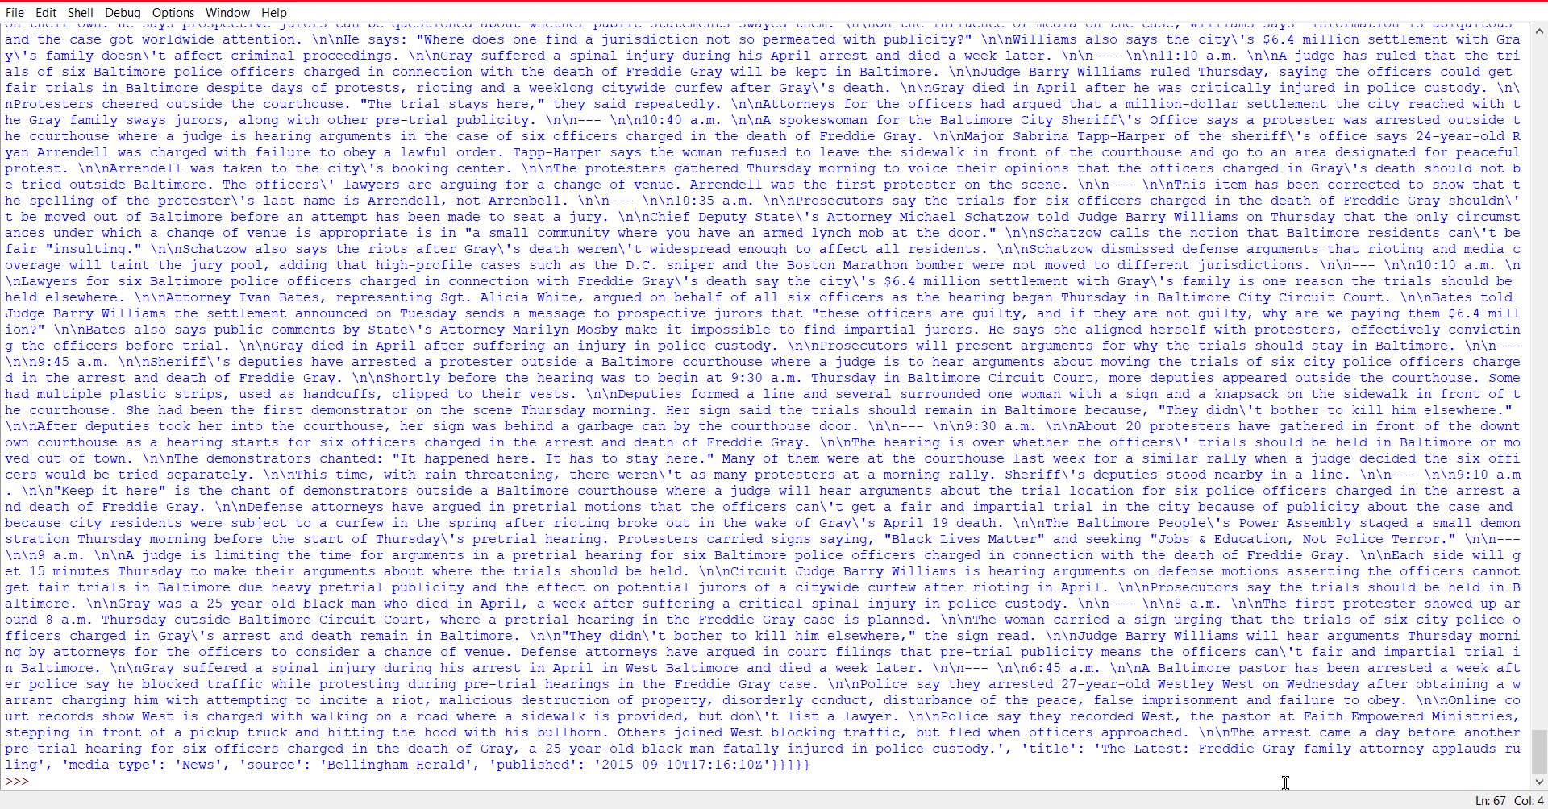
Create Index Pattern -> Searching terms on Kibana Interface
----------------------Query to retrieve Test Collection -> Python Shell Output ----------------------------------------------

Slide 4
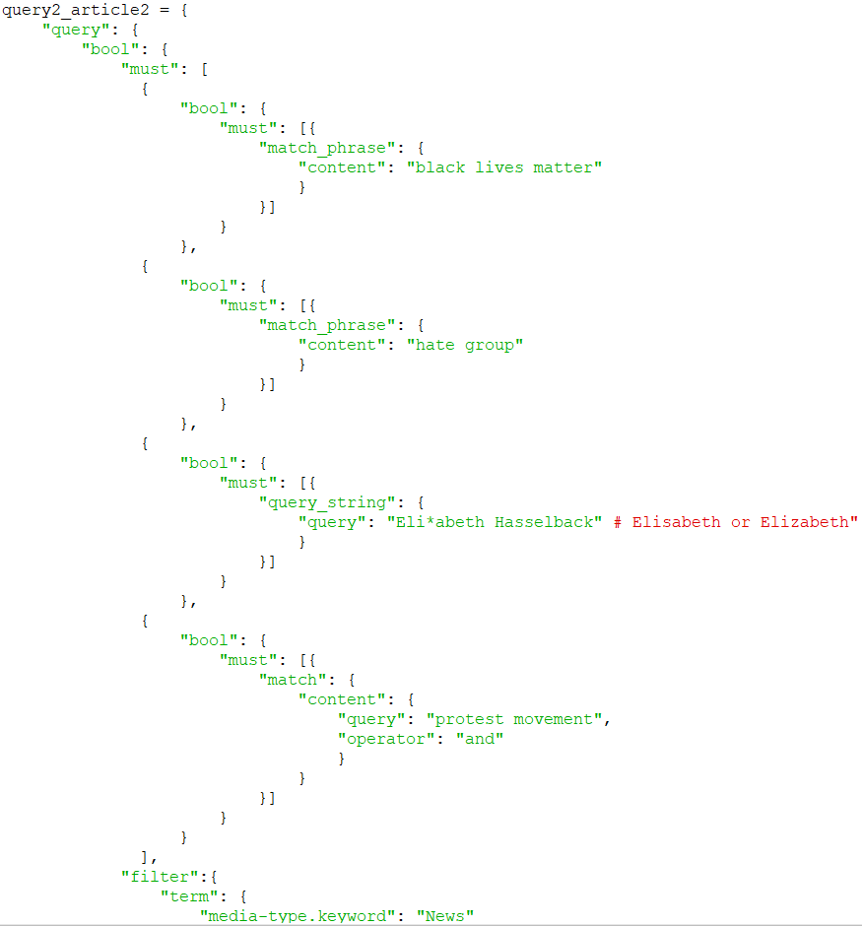
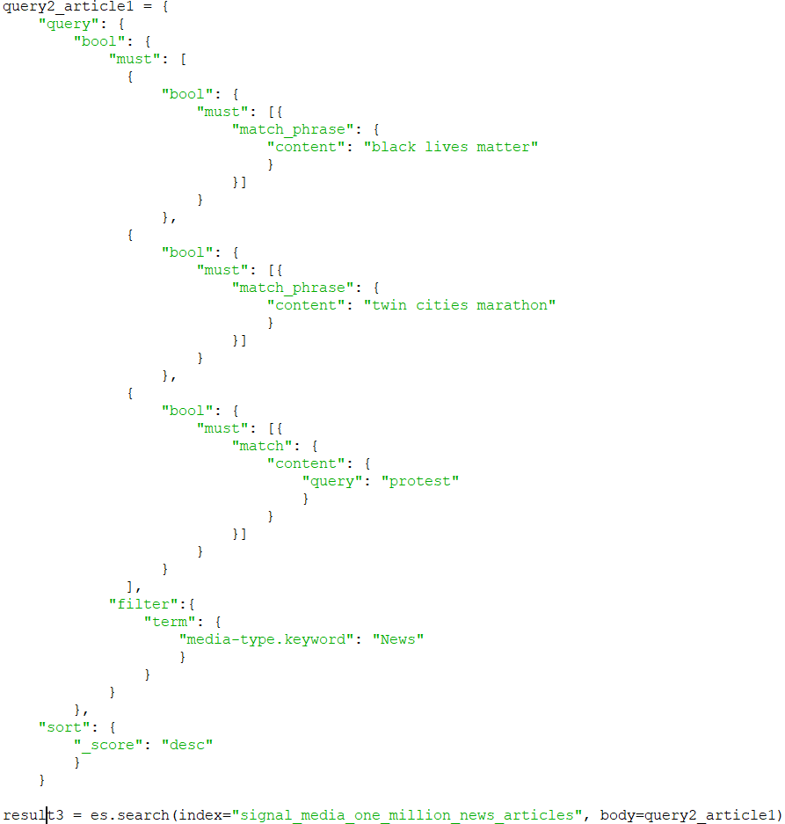

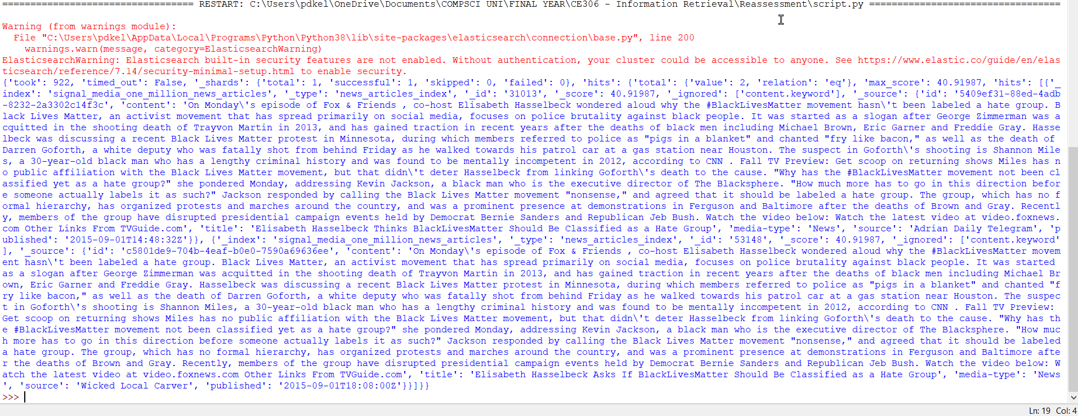

Information Need : writing about Black Lives Matter protests (could be used as a reference or for a source in an academic essay). (Example Queries -> Results in Python Shell)
1
2
3

Slide 5
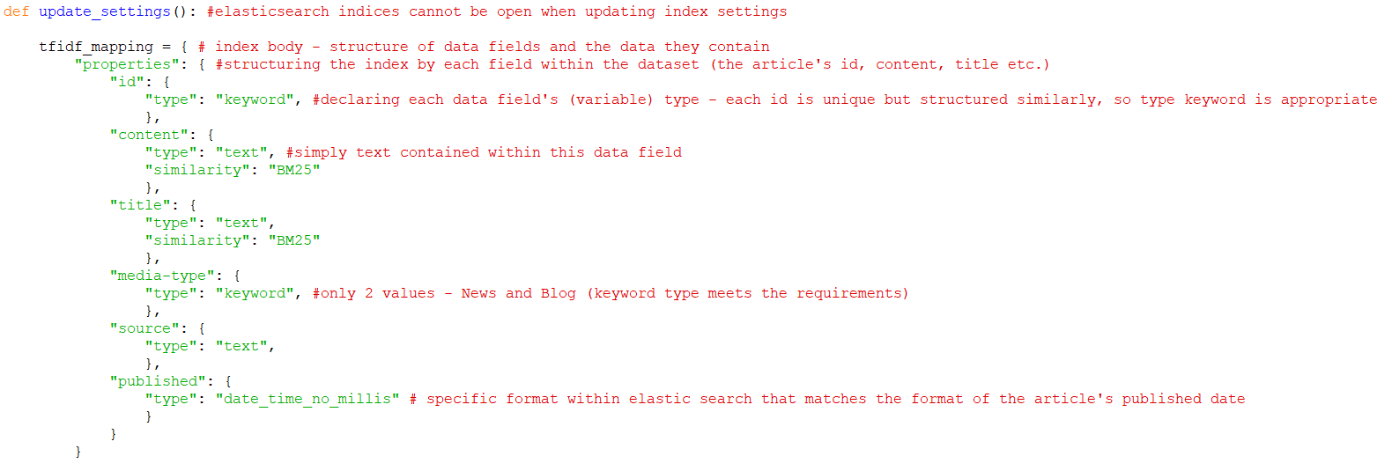

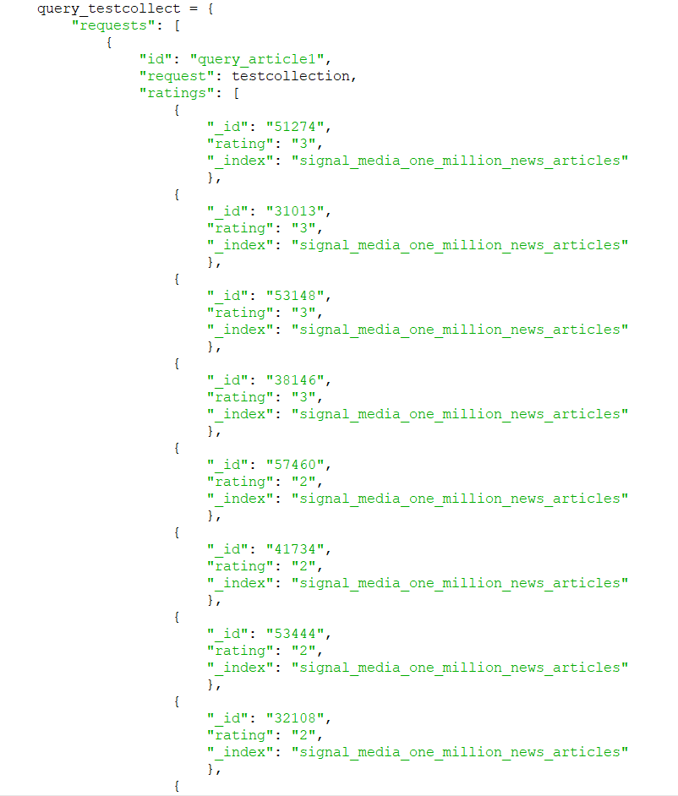

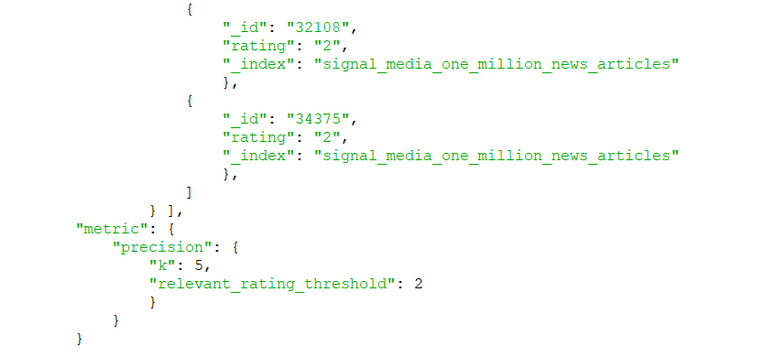

Rank evaluation API Query request
->
rank_eval function
->
Result in Python Shell
Boolean & TF-IDF Retrieval Model Mappings

